Slide 1
L.O: To be aware of the pressure to conform to a physical stereotype.
We will be thinking about:
How the media present images of people.
What a stereotype is.
Positive ways to view our bodies.
The importance of personal well-being.

Slide 2
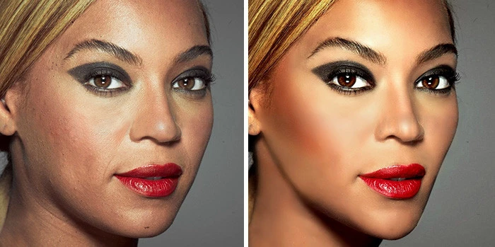
What’s our starting point?
SPOT THE DIFFERENCE!
Write down as many differences as you can see between the two photos of Beyonce.
Why do you think they are different?
What has happened to the photos?

Slide 3
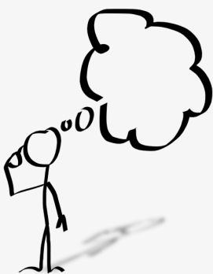
EDITED/
AIRBRUSHED
ORIGINAL
What does edited/airbrushed mean?
Why do you think this has been done?
Where do you think the airbrushed photograph was later used?

Slide 4
EDITED/
AIRBRUSHED
ORIGINAL
Which image do you prefer and why?
Which image do you think Beyonce would prefer and why?

Slide 5
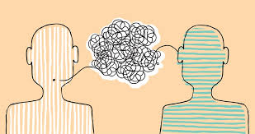
EDITED/
AIRBRUSHED
ORIGINAL
Discuss your thoughts with a partner. Be ready to feedback.
Why do the media show so many pictures of ‘perfect’ celebrities?
Should we all look like this?

Slide 6
REAL
SELF-IMAGE
IDEAL
SELF-IMAGE
It is important to be proud of your REAL SELF IMAGE rather than your IDEAL SELF IMAGE.
Sometimes the IDEAL SELF-IMAGE is not achievable.
However, that is not to say that we can’t change our REAL SELF-IMAGE if we want to.

Slide 7
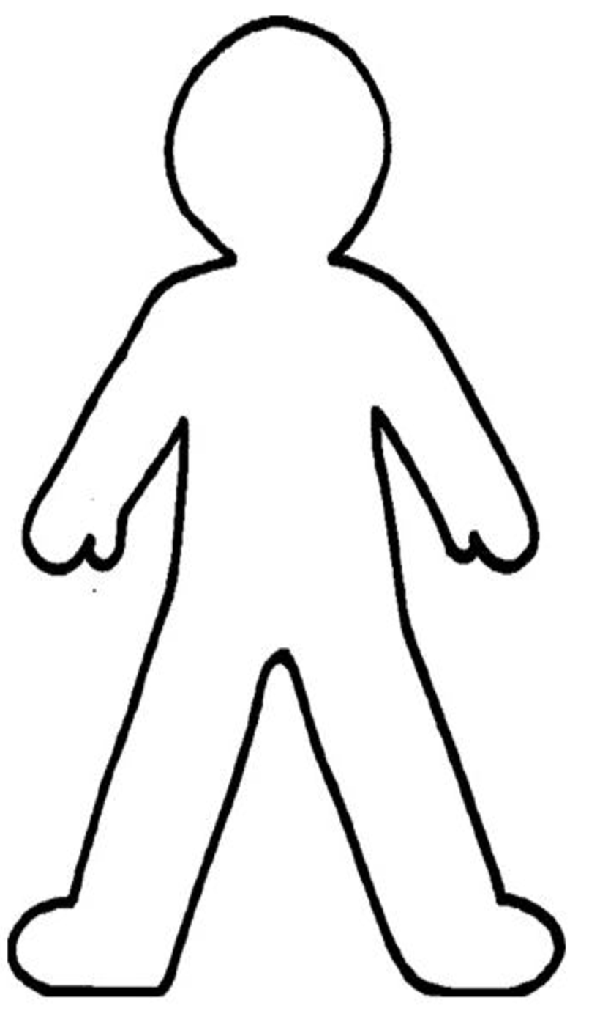
TASK 1:
YOUR REAL-SELF IMAGE
Write as many words as you can inside the body outline to describe your real-self image.
Try to write words about both your appearance and personality.

Slide 8
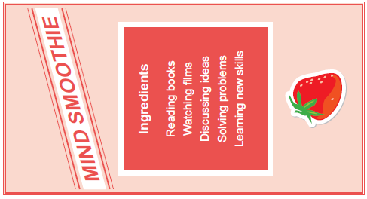
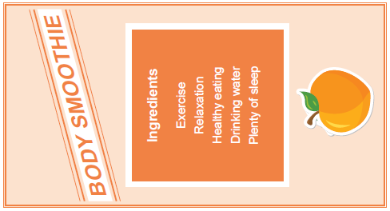
TASK 2:
SELF-ESTEEM SMOOTHIE
Maintaining good mental well-being and self-esteem is important.
Write a list of ingredients to create your own self-esteem smoothie like these examples.

Slide 9
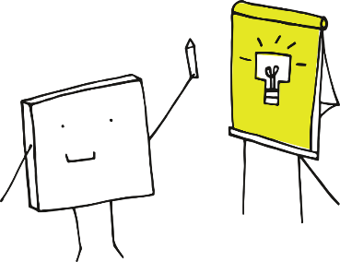
Where are you now?
Let’s share our self-esteem smoothie ingredients.
Reflect…
What have you learnt this lesson about yourself and your self-image?

